Slide 1

Satellite Images Clustering
UsinG FCM Clustering

Slide 2
Introduction
Human eye can notice the major interest object of a picture and ignore others but machine can’t.
So we propose a new method of satellite images based on fuzzy c-means clustering (FCM) to extract an object or cloud.
For example imagine a cloud that hide the main features of the image our method extracts the cloud from the satellite image clearly just like a weather expert.

Slide 3
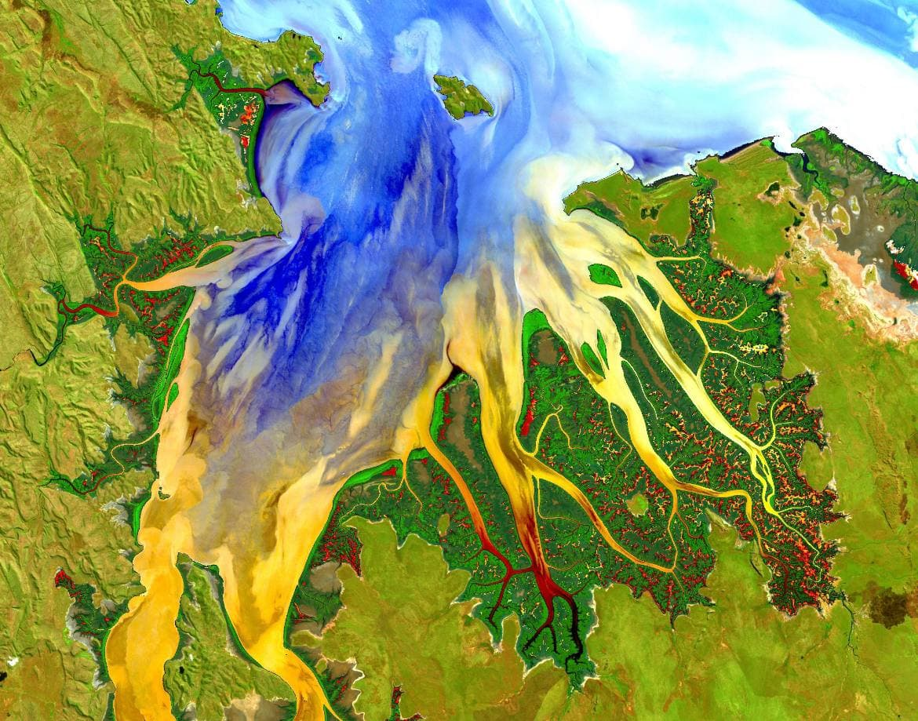
Cambridge gulf Australia

Slide 4
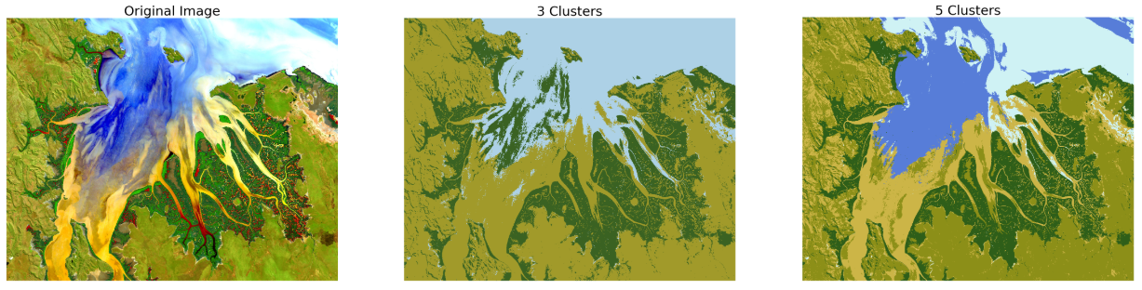
Implementation

Slide 5
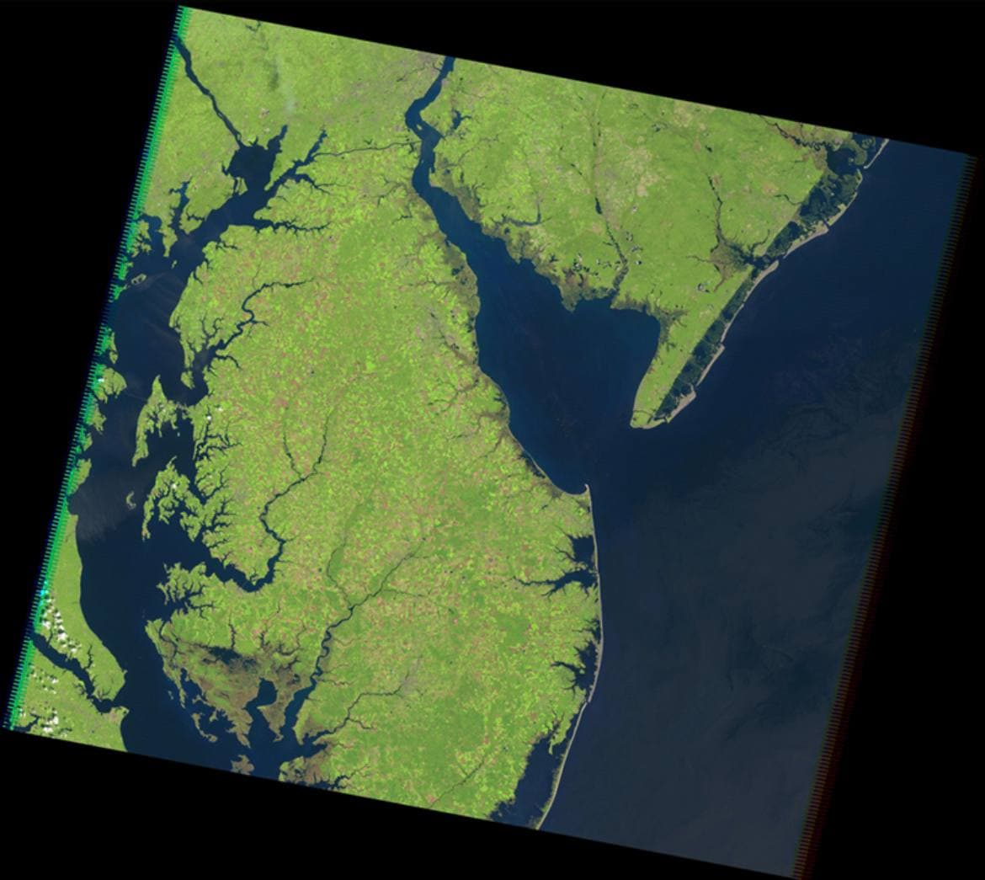
Chesapeake Bay U.S

Slide 6
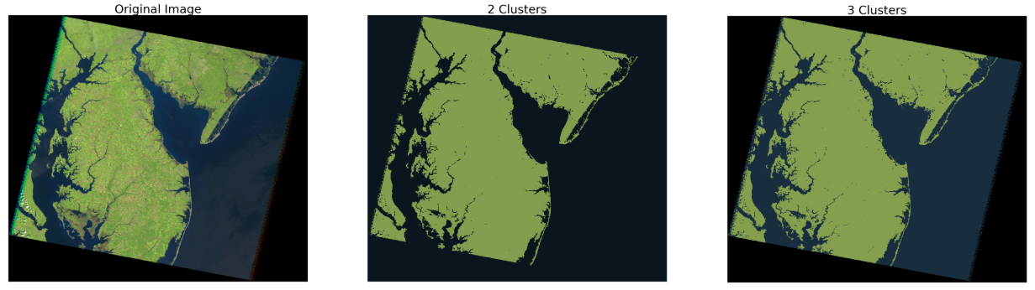
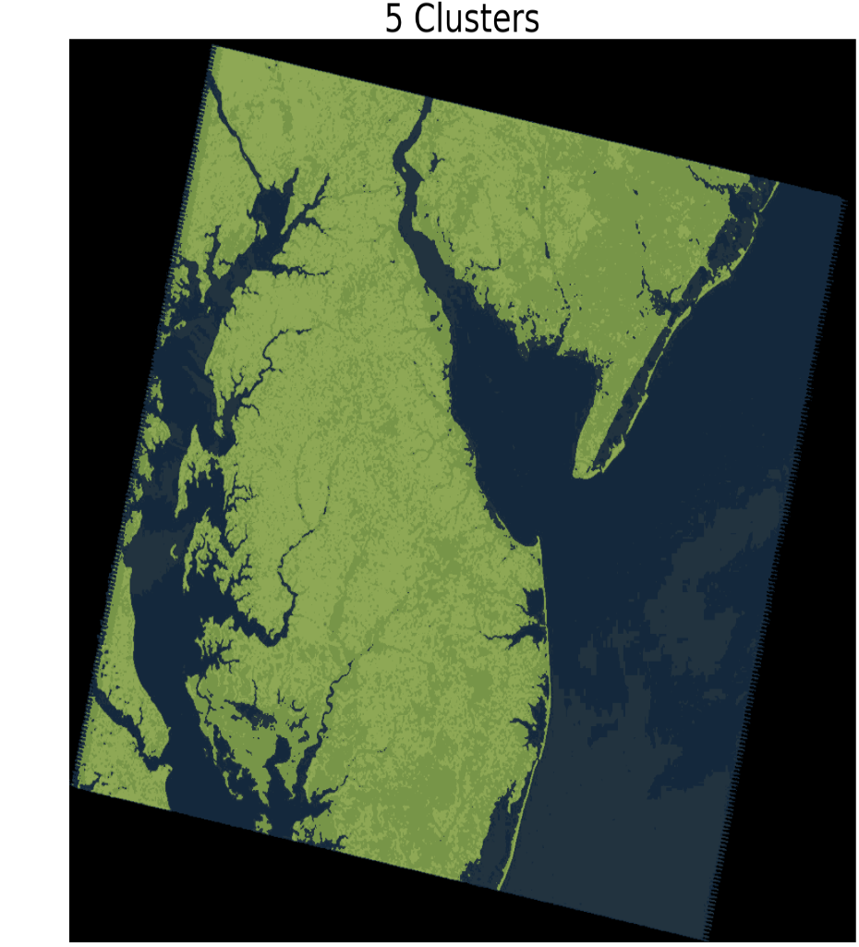
Implementation

Slide 7
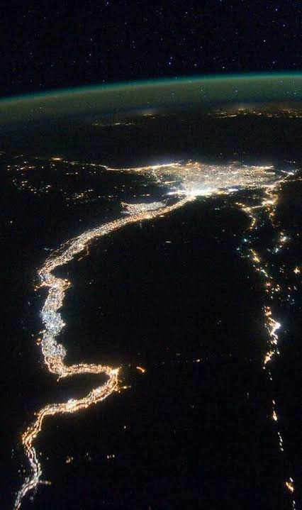
River Nile and Delta Egypt

Slide 8
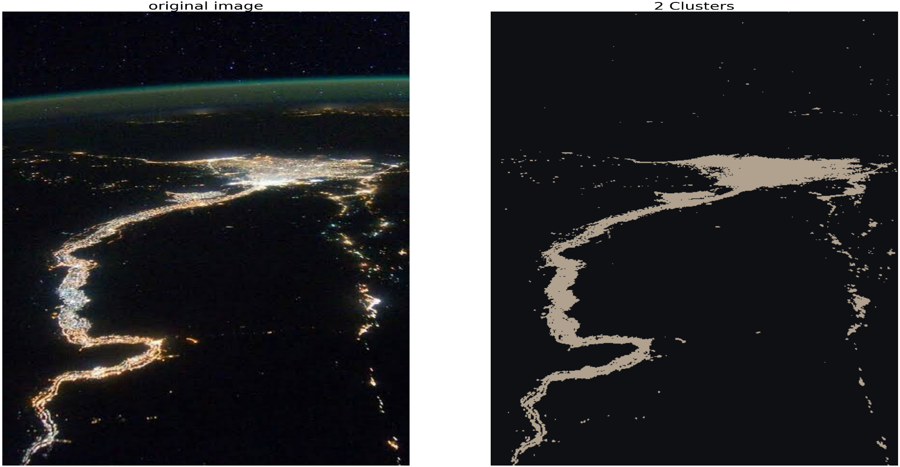
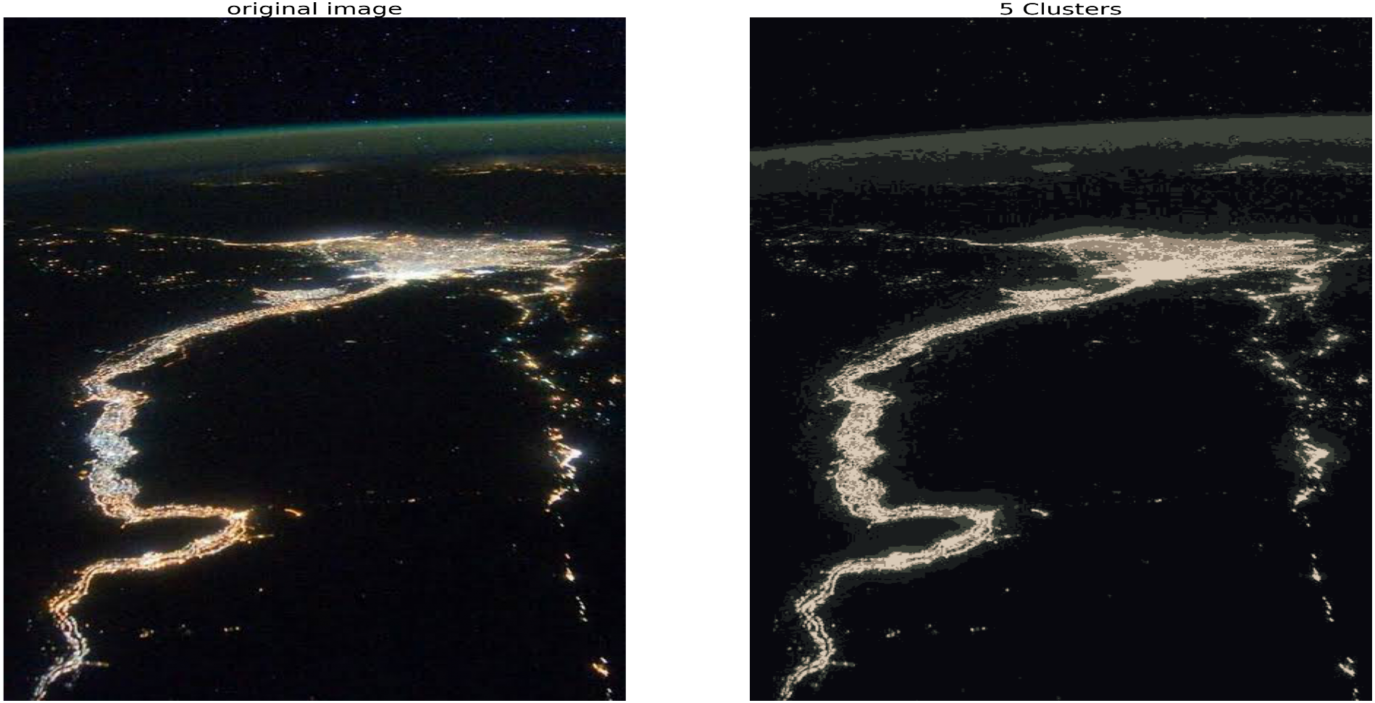
Implementation

Slide 9
Advantages of the project
It hides some features in images that can be useful idea in encryption.
changing the number of clusters , According to details in images you want to show it.
Using small number of clusters enable you to remove noise from images.

Slide 10
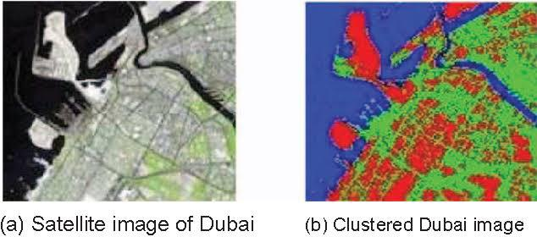
Feature Plan
We will make segmentation for each object in the image by assigning specific color to it.

Slide 11
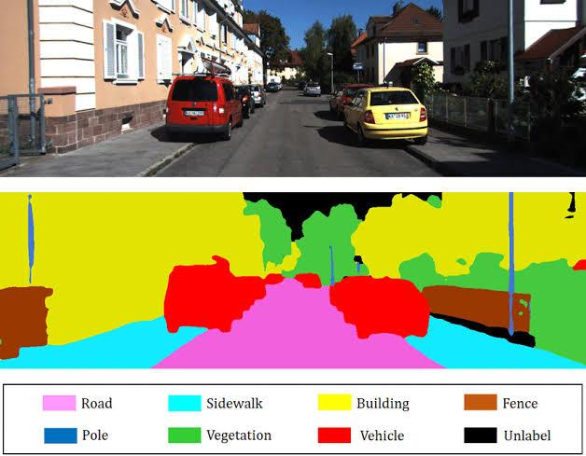
We can use image segmentation in self driving cars.

Slide 12


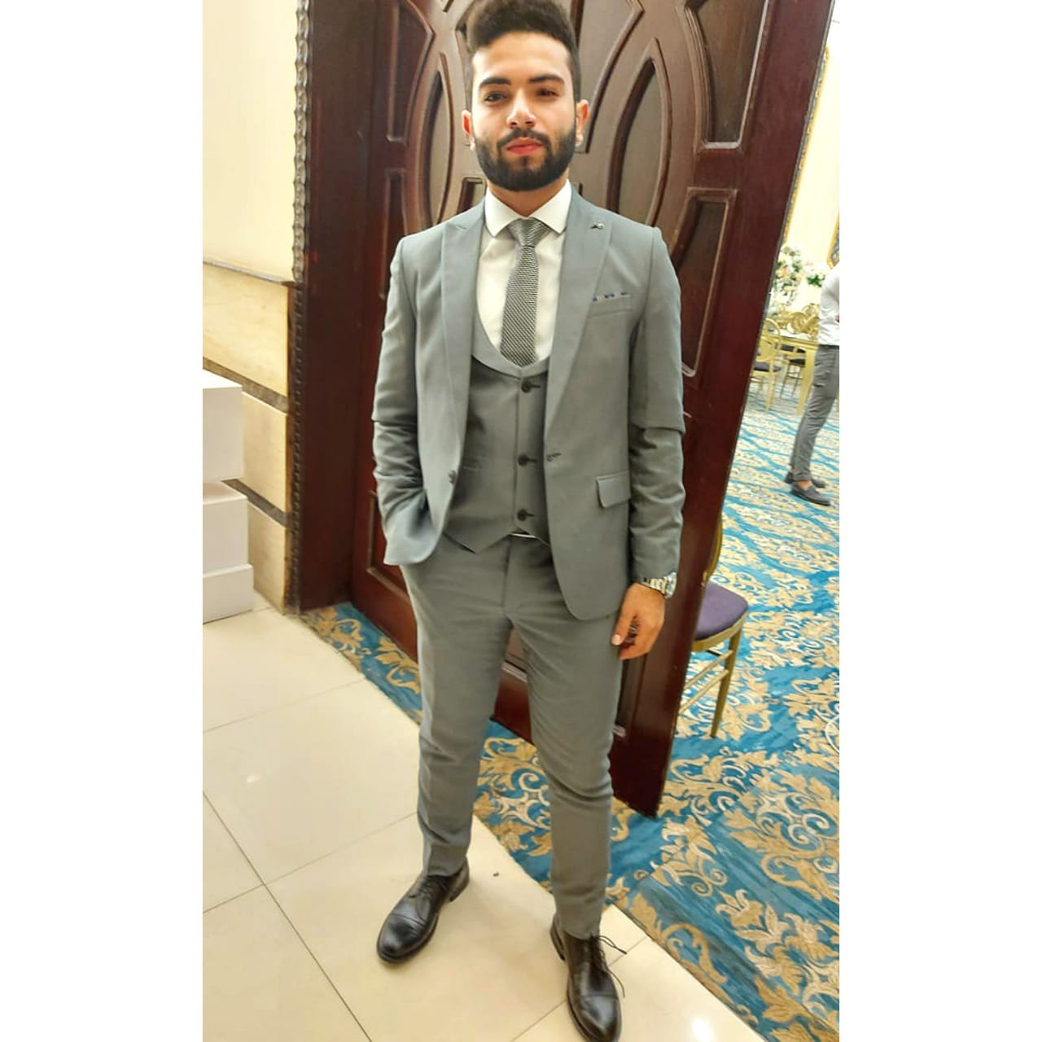

Eng. Ahmed Yasser
Eng. Fatma Mohammed
Eng. Aslm Fawzy
Eng. Ahmed Abd-Elaziz

